Slide 1
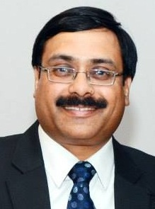
Critical Matters
in
Finance Act 2026 / IT Act 2025
CA. Pramod Jain
FCA, FCS, FCMA, LL.B, MIMA, DISA, IP
Shared at
ICAI – Chh. Sambajinagar Branch (WIRC)
11th April 2026

Slide 2
CA. Pramod Jain
Finance Act 2026

Slide 3
Tax rates
S. 195 – (s. 115BBE) – 60% to 30%
  Surcharge of 25% continues.. Effective rate 39%
  Omit penalty u/s 443
  Subsume this penalty in s. 439(11). (misreporting : Penalty - 200% )
  Clause (g) inserted in s. 439(11) – income referred to in s. 195(b)
    Penalty only if AO assess

Slide 4
Tax rates
S. 206 – (MAT S. 115JB)
  15% to 14%
  No MAT Credit from Tax Year 2026-27
  No fresh MAT credit in old regime. Old allowed till 15 years if shift to S. 200 (115BAA)
  Those who shift – allowed to extent of 1/4th of tax liability for domestic Companies
  Foreign company – full credit

Slide 5
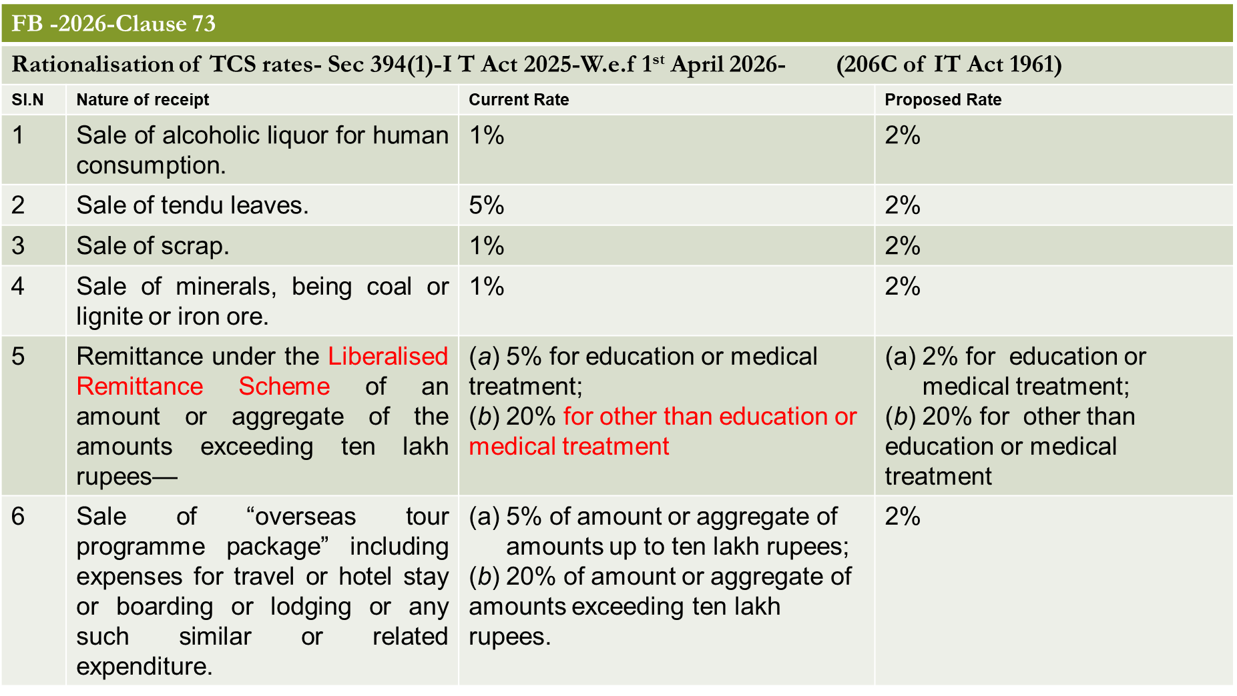
Tax rates –TCS

Slide 6
itrs
3 due dates to 4 now – July split to August
  B/F losses, but no business income during year
  Trust – Memorandum / section
  From AY 2026-27 itself
Revised return with additional fee from January to March
  If filing 1st time post December, then not belated but updated
  5k/1k vis-à-vis 25%
  From AY 2025-26 itself

Slide 7
Revised itrs ??
Case 1
DD – 31/7 filed 30/7, revised 31/12
No late fee
Case 2
DD – 31/7 filed 30/9
Late fee – 5k/1k
Case 3
DD 31/7 filed 30/9, revised 31/12
Late fee for 30/9 – 5k/1k
Case 4
DD 31/7 – filed 31/12, revised 31/1
Late fee 2 times

Slide 8
Updated itrs
Now allowed for:
  Reduction in losses
  If notice u/s 148 / 280
    Can file with addl. 10% tax
    No return then u/s 148/280

Slide 9
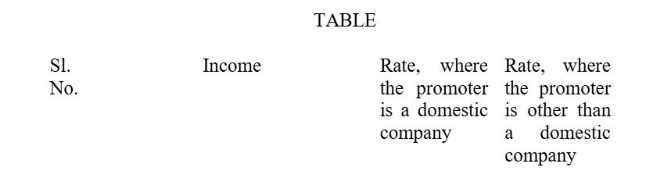
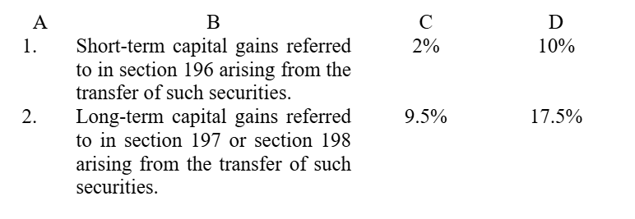
buy-back – cg from 1.4.26

Slide 10
Buy-back tax rates
Type of Gain | Promoter |  | Non-Promoter
 | Domestic Company | Other than Domestic Company
LTCG | 22% | 30% | 12.5%
STCG | 22% | 30% | Applicable / Slab rate
Promoter:
  Listed Co- Regulation 2(k) of SEBI (Buy-back) Reg.
  Other:
    S. 2(69) of Companies Act 2013
    Person who hold directly/indirectly more than 10%

Slide 11
Exempt income
Compensation amount awarded by Motor Accident Claims Tribunal (MACT) including interest
Compulsory acquisition of any land under the RFCTLARR Act.
Exemption for Sovereign Gold Bonds – from original till maturity

Slide 12
Penalty / fEE
Tax Audit – Penalty to Fee - graded
TP Report – Penalty to fee - graded
SFT – Rs. 200 p.d. Max Rs. 1 L – Penalty to fee
Misreporting Penalty 100% / 120% if paid with 30 days++
Penalty order along with assessment Order – Interest on penalty only after 1st appeal order – from 1.4.27

Slide 13
general
No TAN for resident individual / HUF for purchase of residential property from NR w.e.f. 1.10.2026
  Rent, etc.??
  NR to NR??
Employee contribution to ESI/PF – amendment in s. 29 - allowed if paid till due date u/s 263(1)
No deduction against dividend income – earlier 20% if interest
Misreporting Penalty 100% / 120% if paid with 30 days++

Slide 14
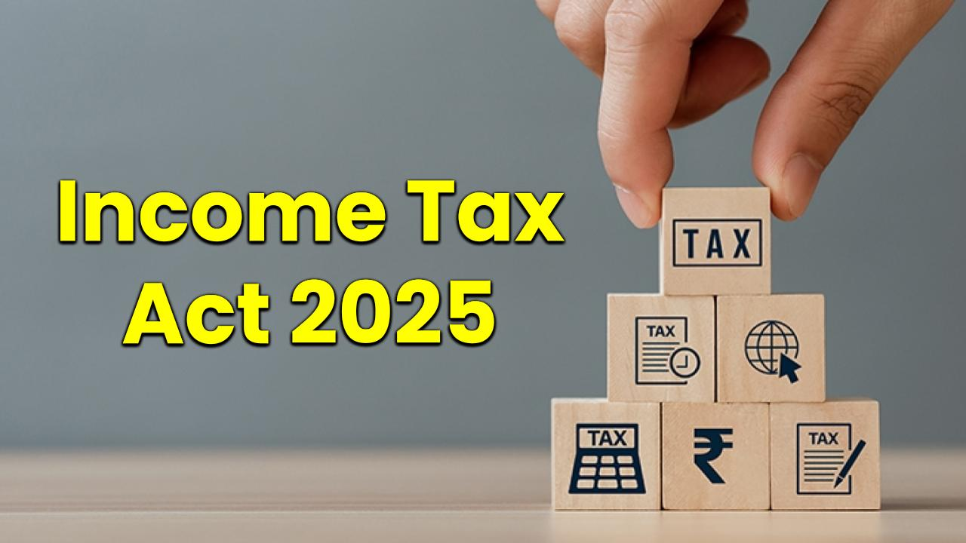

Slide 15
History of income tax in india
IT Act 1860 21.7.1860
IT Act 1886
IT Act 1918
IT Act 1922
IT Act 1961
IT Act 2025

Slide 16
Tax year
Assessment Year

Slide 17
Section 10 (old)
Sch II
To any person – 17 incomes including agriculture
Sch III
Sch IV
Non- Residents, Foreign Co – 17 incomes (Sl. No. 13A to 13C inserted in 2026)
Sch V
Sch VI
IFSC – 12 incomes
Sch. VII
Eligible persons – 42 incomes (Sl. No. 38A to 38D inserted in 2026), including partners, HUF
Persons Exempt – 49 persons
Salary Related
No Schedule - gratuity, leave encashment, Voluntary Retirement Scheme, etc in S. 19
Investment funds, business trusts & unit holders – 8 incomes

Slide 18
Some sections
1961 Act | Related to | 2025 Act
35D | Amortisation of preliminary expenses | 44
44AD/44ADA/44AE | Presumptive Taxation for Residents | 58
44AA | Maintenance of Books | 62
44AB | Tax Audit | 63
47 | Transactions not regarded as transfer | 70
50C | Special provision for full value of consideration in certain cases. | 78
68 | Unexplained Credits | 102
269SS / 269T | Taking / repayment of deposits, loans, etc | 185 / 188
112A | Tax on LTCG in certain cases | 198
115BAC | New Tax Regime | 202

Slide 19
Some sections
1961 Act | Related to | 2025 Act
115JA to 115JF | MAT & AMT | 206
132 | Search & Seizure | 247
133A | Power of Survey | 253
139 | Return of Income | 263
143 | Assessment | 270
147 | Income Escaping Assessment | 279
12A | Application for Registration | 332
11 / 12 / 13 / 80G | Charities | 334 to 355
246A | Appeals to CIT(A) | 357
253 | Appeals to ITAT | 362
193 to 197A / 206C | TDS / TCS | 393 / 394

Slide 20
CA. Pramod Jain
Salaries - deductions
From S. 16 (1961 Act) to S. 19 now
Apart from standard deduction, etc. it includes:
  Gratuity (Old S. 10(10))
  Commutation of Pension (Old S. 10(10A))
  Workmen Compensation (Old S. 10(10B))
  Leave Encashment (Old S. 10(10AA))
  Voluntary Retirement Scheme (Old S. 10(10C))
These deductions are allowed in New Tax Regime too, as per s. 202 (old S. 115BAC).

Slide 21
CA. Pramod Jain
business - deductions
Section 28 now consolidates:
  Old s. 30 (Rent, rates, taxes, repairs & insurance for buildings),
  Old s. 31 (Repairs and insurance of machinery, plant and furniture)
  Old s. 38 (Building, etc., partly used for business, etc., or not exclusively used)

Slide 22
CA. Pramod Jain
business – deductions – Employee welfare
Provisions related to expenses for contributions to PF, Gratuity Fund, Superannuation Fund, etc., were spread across various sections in 1961 Act, such as 40A (7), (9) & 36(1)(iv), (iva), (v) & (va). In 2025 Act, these provisions consolidated under single S. 29.
It includes:
  Contribution towards recog.PF or approved superannuation fund.
  Contribution towards a pension scheme.
  Contribution towards an approved gratuity fund.
  Contribution received from an employee (ESI, PF).
  Non allowability for setting up or formation of, or as contribution to, any fund, trust, company, AOP, BOI, society
  Non- allowability for gratuity unless paid.

Slide 23
CA. Pramod Jain
books
Section 62 as compared to Old S. 44AA
Specified profession - Information Technology and Company secretary professions have been added in the section as specified professions, earlier - notifications.
Earlier books of accounts were required for assessee, who was engaged in business which was covered u/s 44AD(4) and his TI exceeded the MANCT. Now:
  condition of TI exceeding MANCT is not there,
  hence even if an specified assessee is not declaring profits as per presumptive basis and as his income is below MANCT
  consequently tax audit is not required,
  still the assessee would have to prepare its books of accounts.

Slide 24
CA. Pramod Jain
Audit / presumptive taxation
Section 58 (Old s. 44AD/44ADA/44AE) r.w.s. 63 (Old S. 44AB)
Earlier Old S. 44AD was optional, now seems to be mandatory.
Now declaring income lower than specified % of profit, and its TI exceeds MANCT, requirement is to:
  Maintain books of accounts; and
  Get the audit done u/s 63
However, u/s 63, condition of TI exceeding MANCT is not mentioned.
Earlier condition of TI exceeding MANCT was not there for business of plying, hiring or leasing of goods carriage, which is now required in 2025 Act.

Slide 25
CA. Pramod Jain
Unexplained sums
1961 | Heading | 2025 | Heading
68 | Cash Credits | 102 | Unexplained Credits
69 | Unexplained Investments | 103 | Unexplained Investment (69 & part of 69B)
69A | Unexplained Money, etc. | 104 | Unexplained Asset (69A & part of 69B)
69B | Amt. of Investments, etc. not fully disclosed in books of Accounts
69C | Unexplained expenditure, etc. | 105 | Unexplained Expenditure
69D | Amt. borrowed or repaid on hundi | 106 | Amt. borrowed or repaid through negotiable instrument, hundi, etc.
‘May’ replaced with ‘Shall’ except for S. 69D (as it already had ‘shall’)

Slide 26
CA. Pramod Jain
charities
2.50 L ITR for AY 2023-24. They applied Rs 10 L Crs. for charitable & religious purposes in FY 2022-23
1961 provisions
  Chapter I: Charitable Purpose (S. 2(15))
  Chapter III: S. 10(23C), 11, 12, 12A, 12AA, 12AB, 12AC & 13
  Chapter VIA: Section 80G
  Chapter XII / XIIEB: Sections 115BBC, 115BBI, 115TD, 115TE, 115TF

Slide 27
CA. Pramod Jain
charities
2025 Act – Sections 332 to 355
  Unified term "registered non-profit organization" is used instead of various terms like trust, institution, etc.
  "Registration" replaces "approval"
  All provisions are consolidated in Part B of Chapter XVII under "Special Provisions for Registered NPOs."
Capital gains u/s 11(1A) done away with.
Deemed application under Explanation 1(2) of section 11(1) done away wit. Accumulation u/s 11(2) for up to five years continues

Slide 28
CA. Pramod Jain
Chapter Xvii - part b
Special provisions for registered non-profit organisation
Sub-Part | Heading | Sections
1 | Registration | 332-333
2 | Income of registered non-profit organisation | 334-343
3 | Commercial activities by registered non-profit organisation | 344-346
4 | Compliances | 347-350
5 | Violations | 351-353
6 | Approval for purpose of deduction under section 133(1)(b)(ii) | 354-355

Slide 29
CA. Pramod Jain
charities
Now only certain persons specified can register – S.332
Application, duration, validity, etc. all in one table
Incomes:
  Regular income.
  Specified income.
  Income not to be included in regular income.
  Corpus donation.
  Deemed corpus donation

Slide 30
tds
65 sections in 1961 Act specifying TDS liabilities, based on payer / payee's status & applicable limits, consolidated into 2 – S. 392/393.
Now it is a ready-reckoner itself. S. 393 contains tables for:
  Sub s. (1) - Payments to Residents – 8 incomes
  Sub s. (2) - Payments to Non-residents – 17 incomes
  Sub s. (3) - Payment to any person – 7 incomes – lottery, 194T..
  Sub s. (4) - No TDS required – 19 Sl. Nos. (exceptions)
  Sub s. (5) - Declaration for no TDS – 15G/H Now Form No. 121
For Resident payees, similar types of income (like commission, rent, interest, etc.) are grouped together.

Slide 31
Tds - Residents
Payments to Residents
  Commission / brokerage
  Rent
  Transfer of immovable property
  Income from Capital market
  Interest income
  Contractors, FTS and professional services
  Dividend
  Other cases
UDIN introduced for real-time verification through the ICAI API - Tax audit /15CB.

Slide 32
TCS
Provisions related to TCS also consolidated – S. 394.
It includes one table listing the nature of receipts, monetary thresholds, collectors, and applicable TCS rates.
Conditions for no collection of TCS are also in it.
Other Provisions that were scattered across existing Act are now consolidated into independent sections:
    Certificates (such as Lower Deduction/Collection Certificates) – S. 395
    Compliance and reporting (filing of statements, etc.) – S. 397
    Consequences of failure to deduct or collect tax, or failure to pay the deducted/collected tax – S. 398
    Processing of statements – S. 399

Slide 33
relative
S. 2(94) - expanded to include both maternal as well as paternal lineal ascendant.
  Husband,
  Wife,
  Brother,
  Sister
  Any lineal ascendant (maternal as well as paternal)
  Descendant of that individual;
Relatives are also defined in ss. 92(5)(g), 355(i) and 515(8) which is much wider than as defined in 2(94).
  S. 92(5)(g) (S. 56(2)(x) of 1961 Act), This is also applicable for purposes of GAAR - s. 184(8).
  S. 355(i) - Special provisions for registered non-profit organization.
  S. 515(8) - defining authorized representative & Accountant (CA).

Slide 34
relative
Relatives defined in ss. 92(5)(g), 355(i) and 515(8):
  spouse;
  brother or sister;
  brother or sister of the spouse;
  brother or sister of either of the parents;
  any lineal ascendant (maternal as well as paternal) or descendant;
  any lineal ascendant (maternal as well as paternal) or descendant of the spouse;
  spouse of the person referred to in 2 to 6
Apart from these 3 provisions, term used in the Act would mean as per this sub-section, unless specifically defined, like in s. 129(3)(e), which is for the purpose of education loan interest deduction for relative.

Slide 35
S. 149 / S. 282
Notice Type | Condition (Likely Income Escaped) | 1961 Act (S. 149) Time Limit | 2025 Act (S. 282) Time Limit
Show cause / Pre Notice (S. 148A / S. 281) | < Rs. 50 Lacs | Within 3 years from end of AY | Within 4 years from end of Tax year
Show cause / Pre Notice (S. 148A / S. 281) | > Rs. 50 Lacs | Within 5 years from end of AY | Within 6 years from end of Tax year
Reassessment Notice (S. 148 / S. 280) | < Rs. 50 Lacs | Within 3 years 3 months from end of AY | Within 4 years 3 months from end of Tax year
Reassessment Notice (S. 148 / S. 280) | > Rs. 50 Lacs | Within 5 years 3 months from end of AY | Within 6 years 3 months from end of Tax year

Slide 36
PAN DATA correction
Form No. | Purpose
PAN CR-01 | For Individual – Request for changes or correction in PAN Data
PAN CR-02 | For Non-Individual – Request for changes or correction in PAN Data
Vide Order dated 1st April 2026 – S. 262(4) read with Rule 158(12)

Slide 37
1961 act repealed
1961 Act repealed vide s. 536 (Repeal and savings)
Repealed Act to continue to apply to any pending proceedings
Penalty can be imposed in the repealed Act
Losses allowed to be carried forward
MAT / AMT also allowed to be carried forward
Many other allowed…
General clauses Act applicable

Slide 38
in ty 2026-27 ????
ITR for AY 2026-27
TDS / TCS for TY 2026-27
Advance Tax for TY 2026-27
Self assessment tax for AY 2026-27
Presumptive Income
Books
Lower TDS/TCS certificate form
Forms for informing other income / tax regime to be chosen by employee to employer

Slide 39
Forms / rules
333 Rules as compared to 130 ++
190 Forms Eg. for PAN allotment - 4 forms (93-96 / 49A & 49AA of 1962 Rules)
Form 26 - Form 3CA/CB/CD
Form 44 – Form 67
Form 48 – Form 3CEB
Form 121 – Form 15G/H
Form 130 / 131 – Form 16/16A
Form 145/146 – Form 15CA/CB

Slide 40
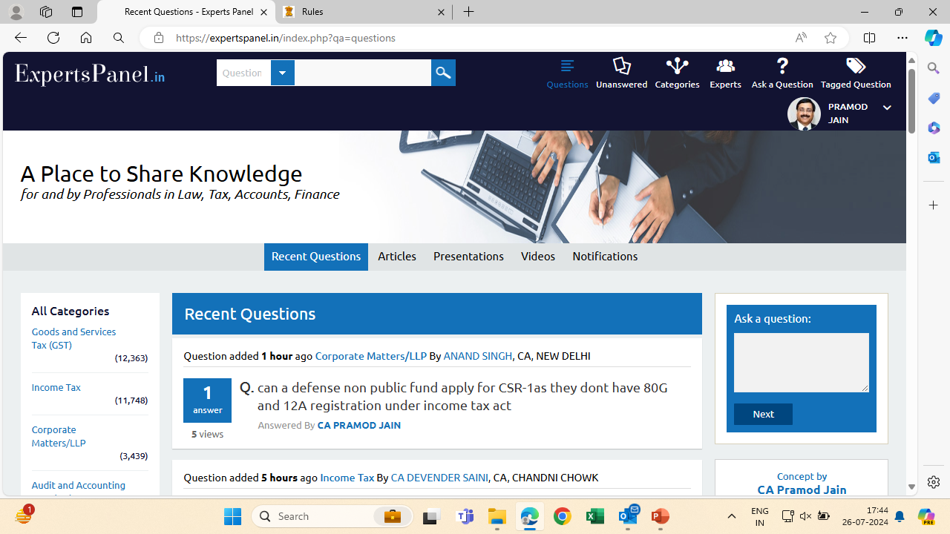
A one stop place where all your Queries are answered by various Experts
www.expertspanel.in

Slide 41
This Presentation would be available on
www.lunawat.com
Also may download free mobile app
“LUNAWAT”
For all updates & Ready to use Charts since year 2007

Slide 42

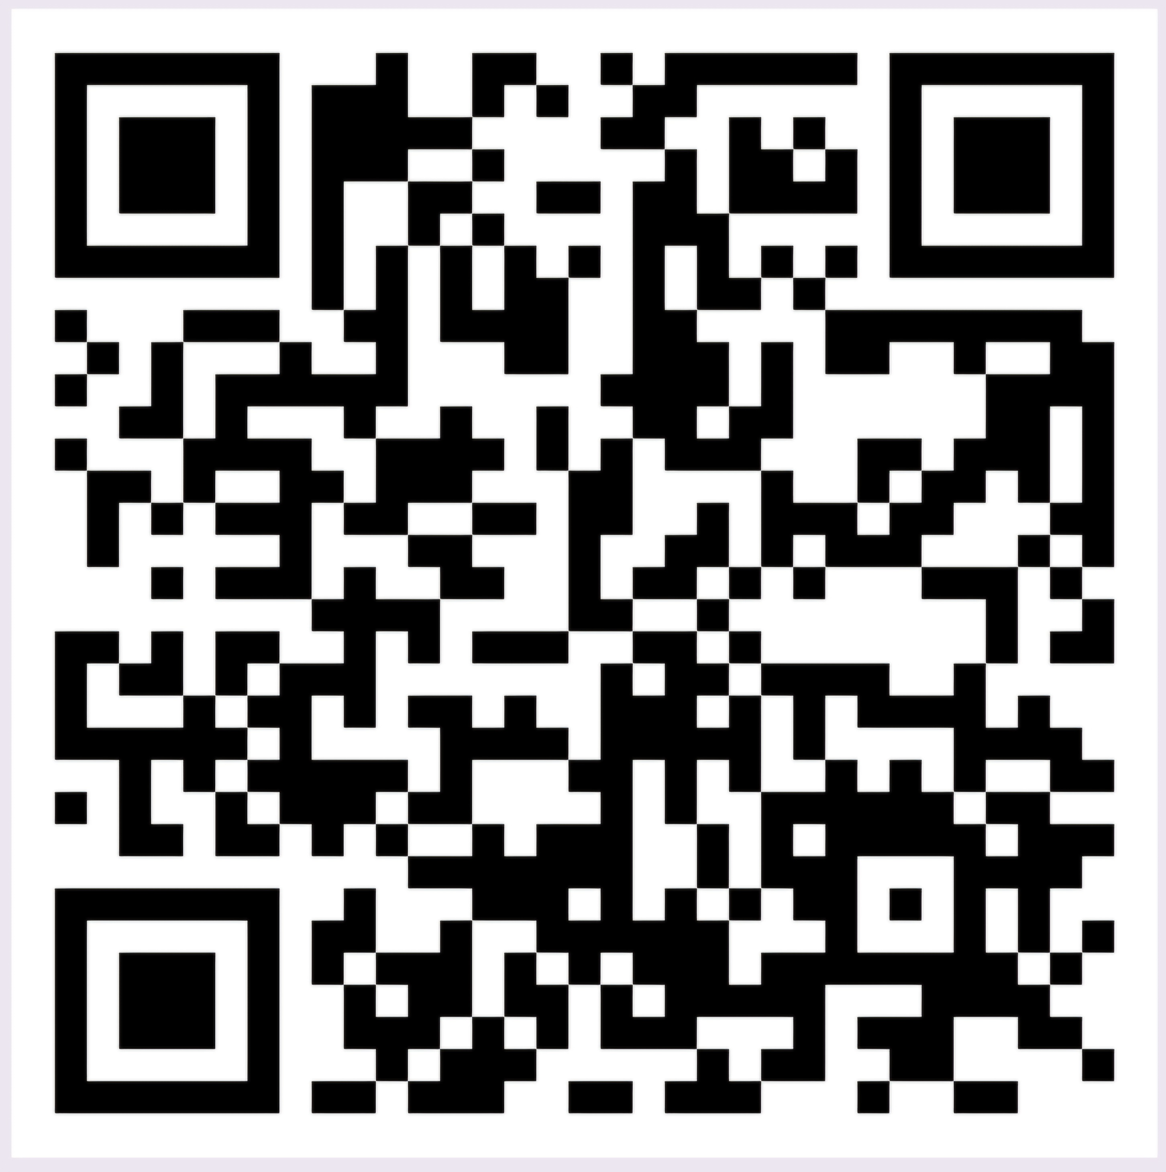





CA. Pramod Jain
www.capramodjain.com
pramodjain@lunawat.com
+91 9811073867
© 2026 CA. Pramod Jain, Lunawat & Co.

